Slide 1
Shop Stop
An online E-commerce website

Slide 2
ITW PROJECT
Romit Mondal
Roll no- 18075051
Shayak Das
Roll no- 18075056
Neha Kumari
Roll no- 18074012

Slide 3
Skills Required
Django
HTML,CSS,
Javascript
Bootstrap
Python package

Slide 4
Packages Required
Pillow
To support image fields
Allauth
For social accounts authorization
Pytz
For date-time access location-wise

Slide 5
Features of website :

Slide 6


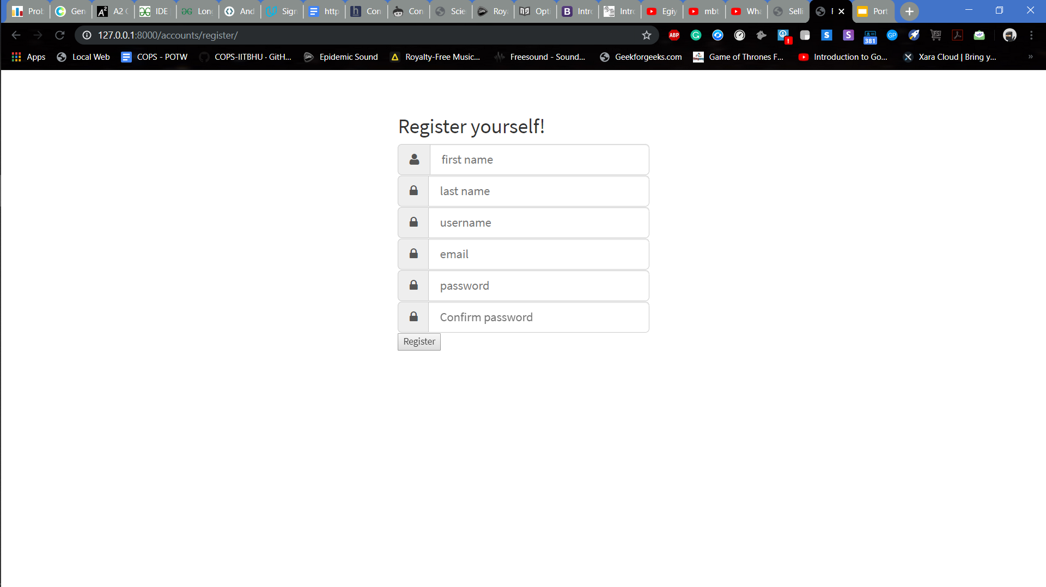
Login Register
We can login , register with email and the system greets you with your name and also an option to logout.
Security checks:
Email taken check
Password not matching
Username taken check

Slide 7
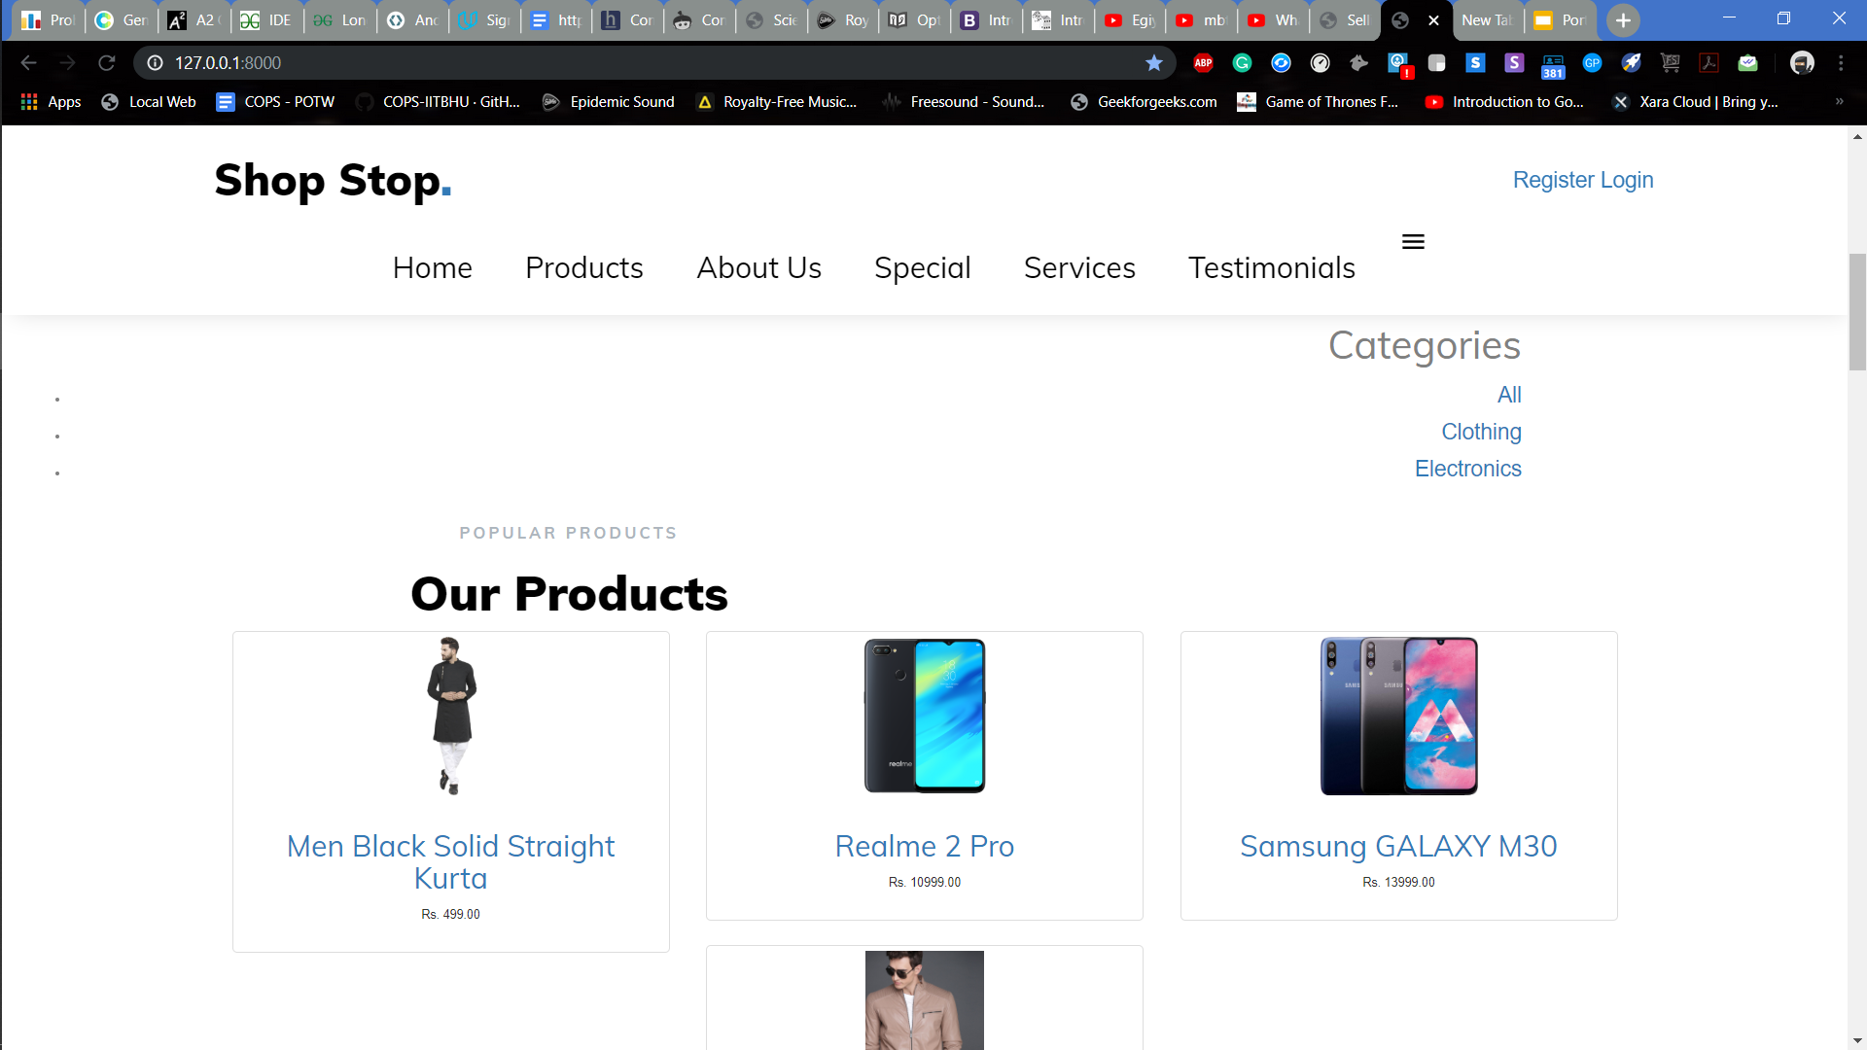
Category-wise sorting
Products available can be sorted given the categories.

Slide 8
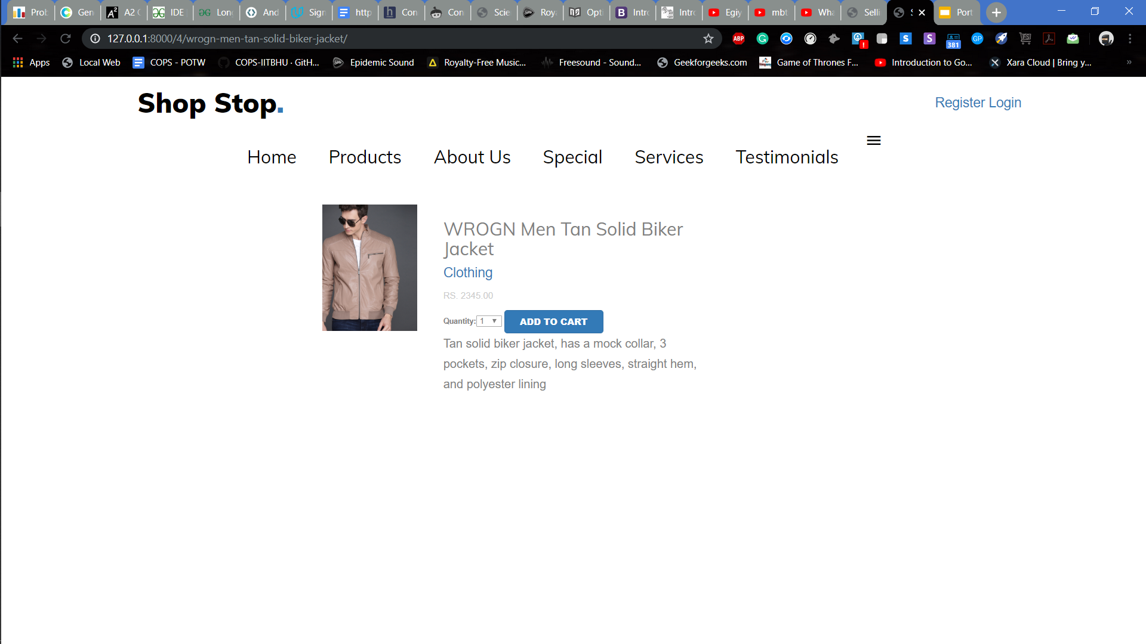
Product-detail page
Product detail page for each product with also an option to add to cart from here.

Slide 9
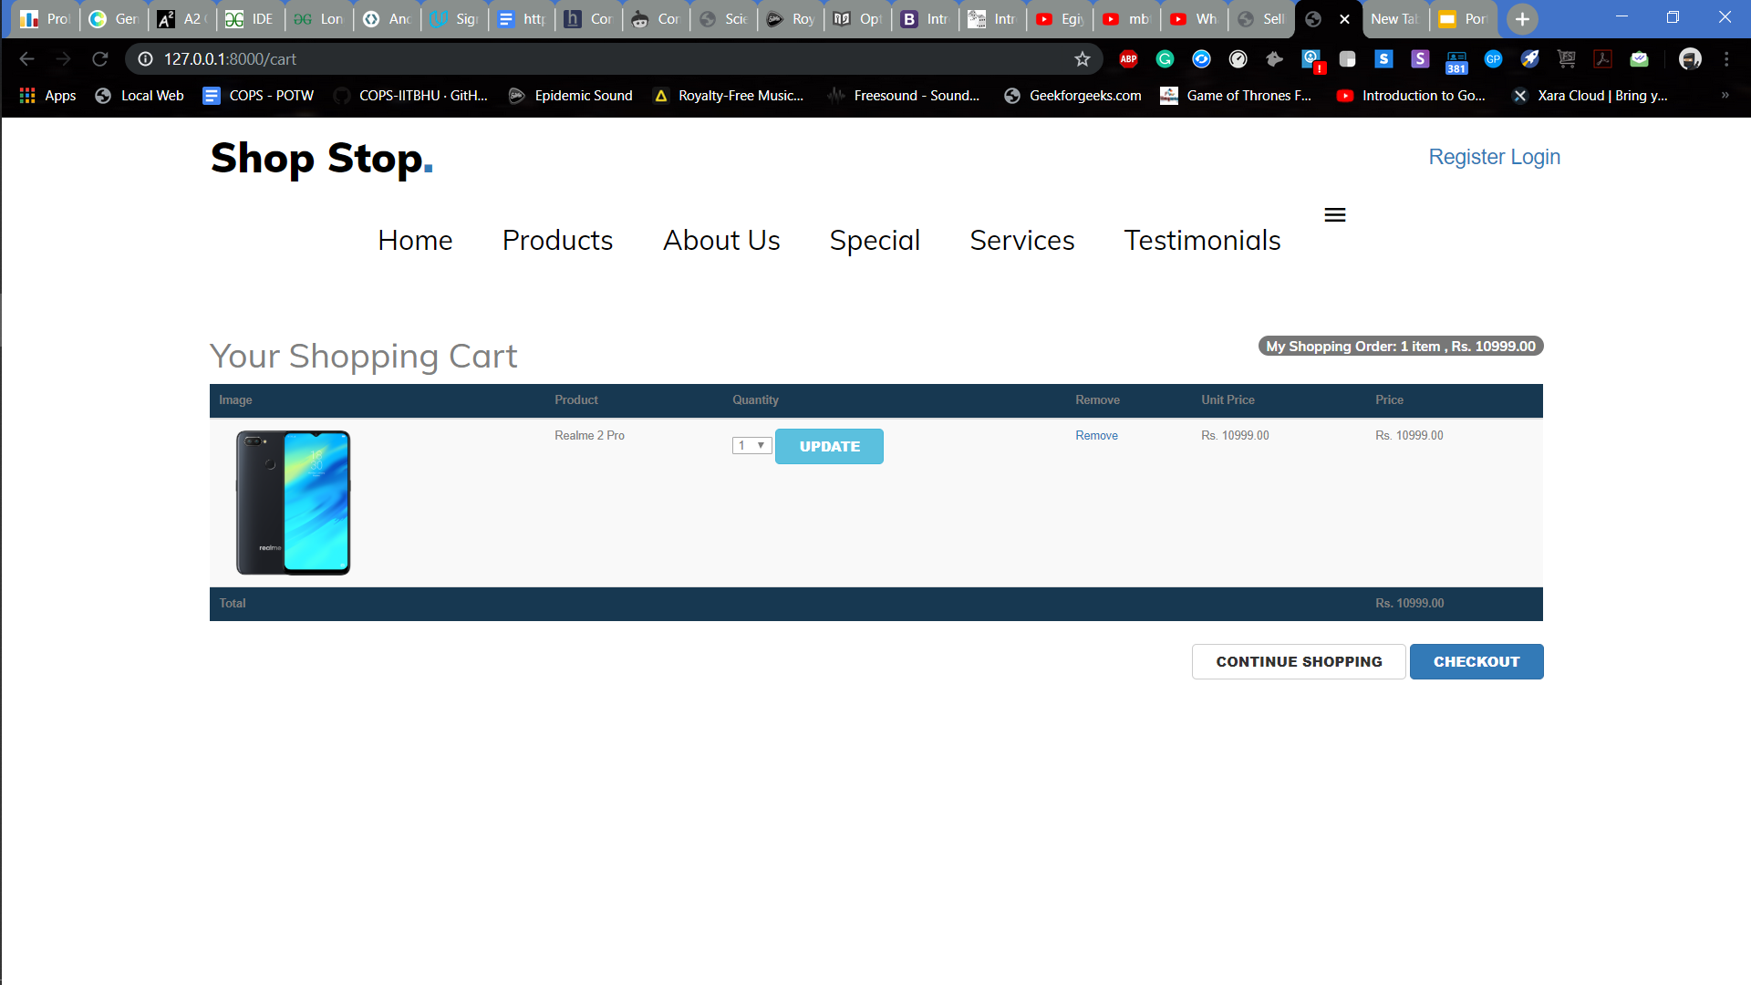
Cart
Cart showing us the products added and also an option to update the cart as required.

Slide 10
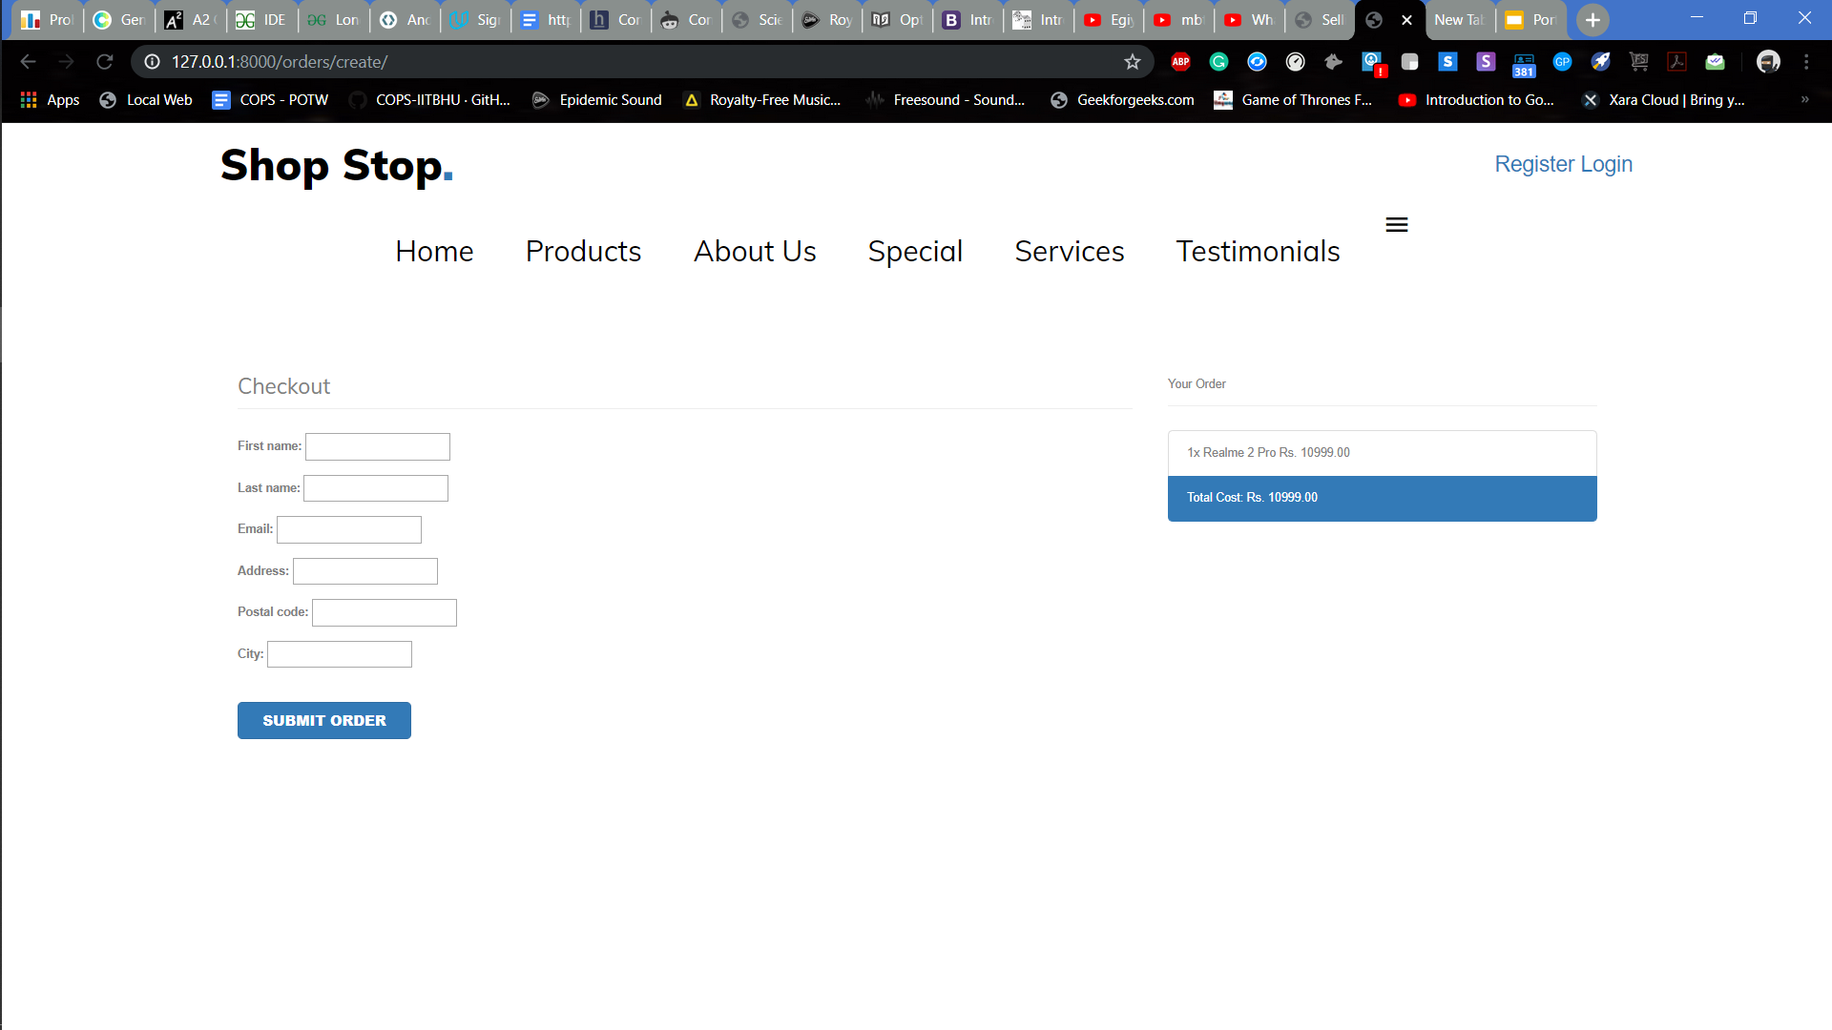
Checkout Page
The checkout page is a submit form which if filled , stores the order in the database to be processed for further action like payment , delivery , etc.

Slide 11
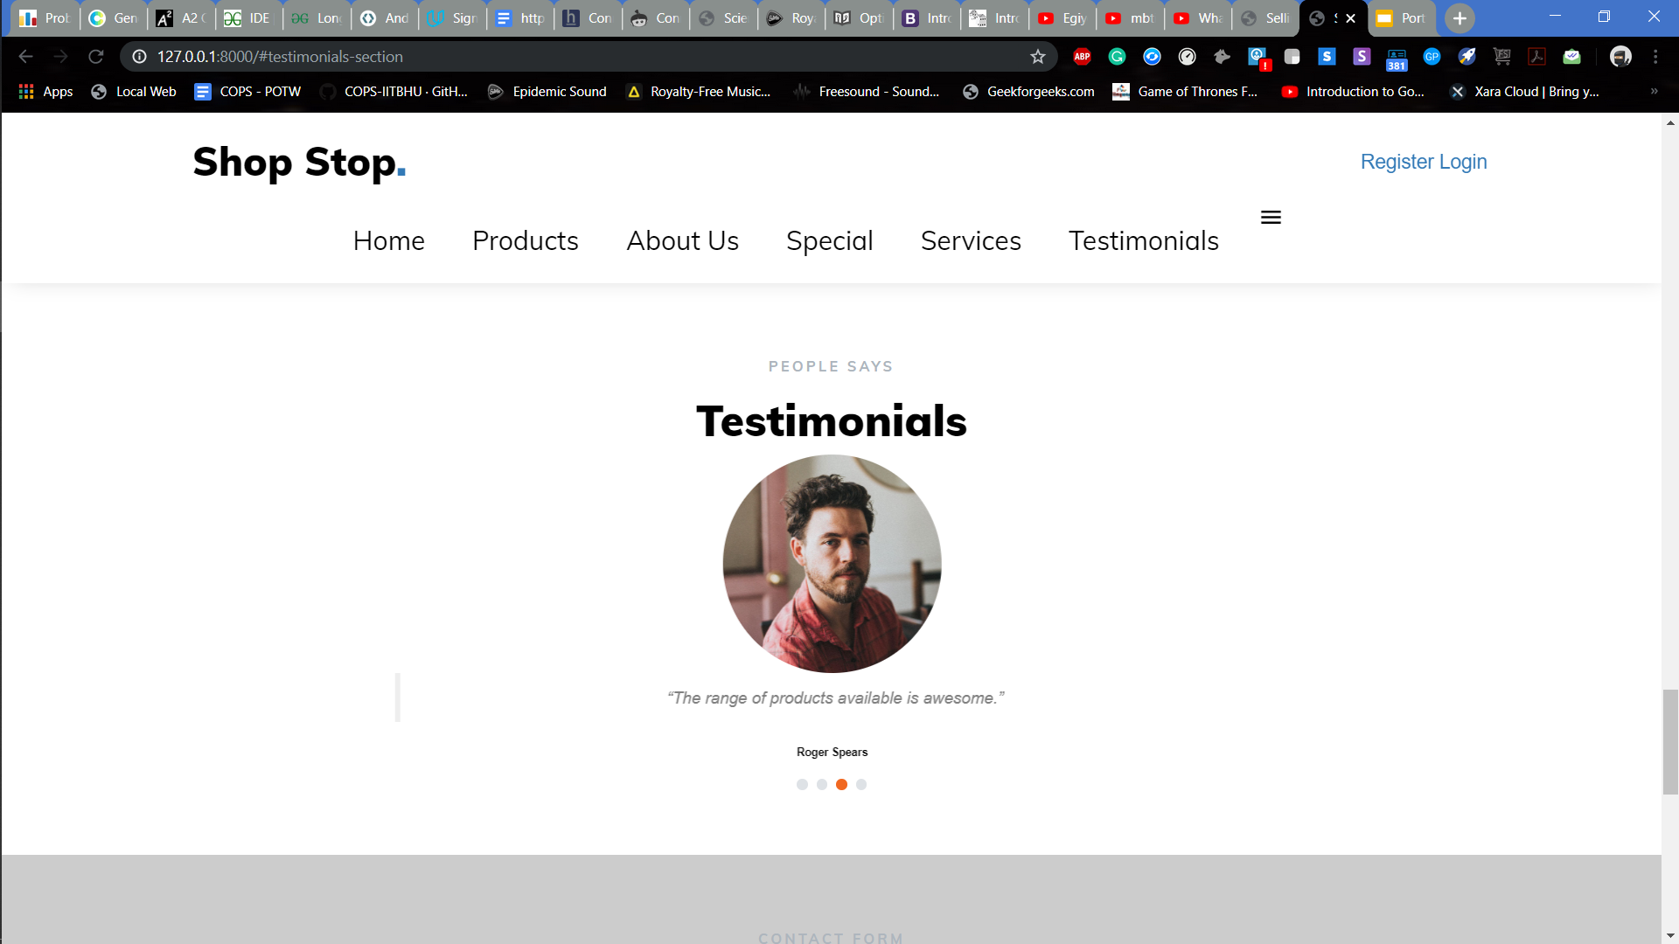
Testimonials
Where the people can remark or comment on the service of the application

Slide 12
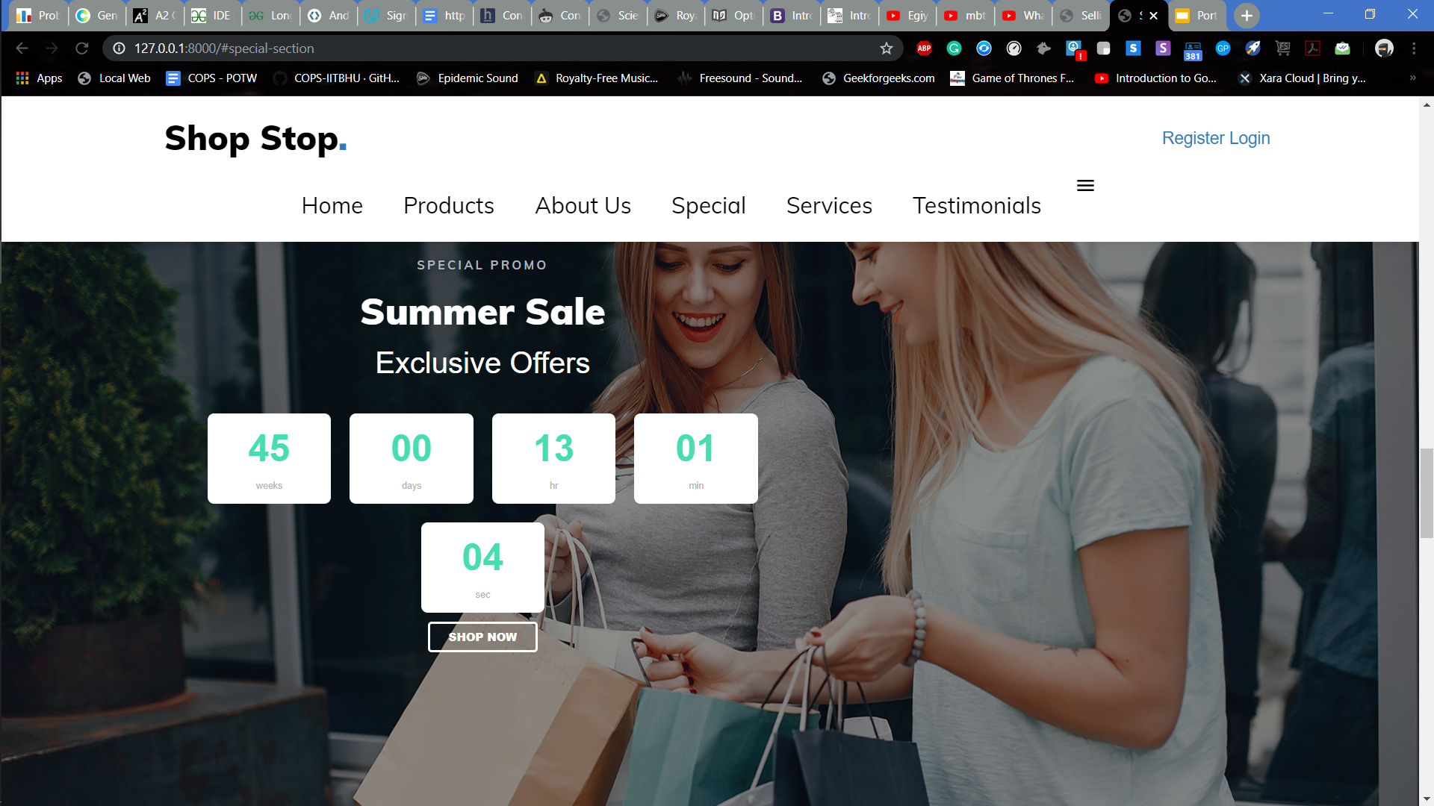
Timer for Summer Sale
Days to go for a particular sale .

Slide 13
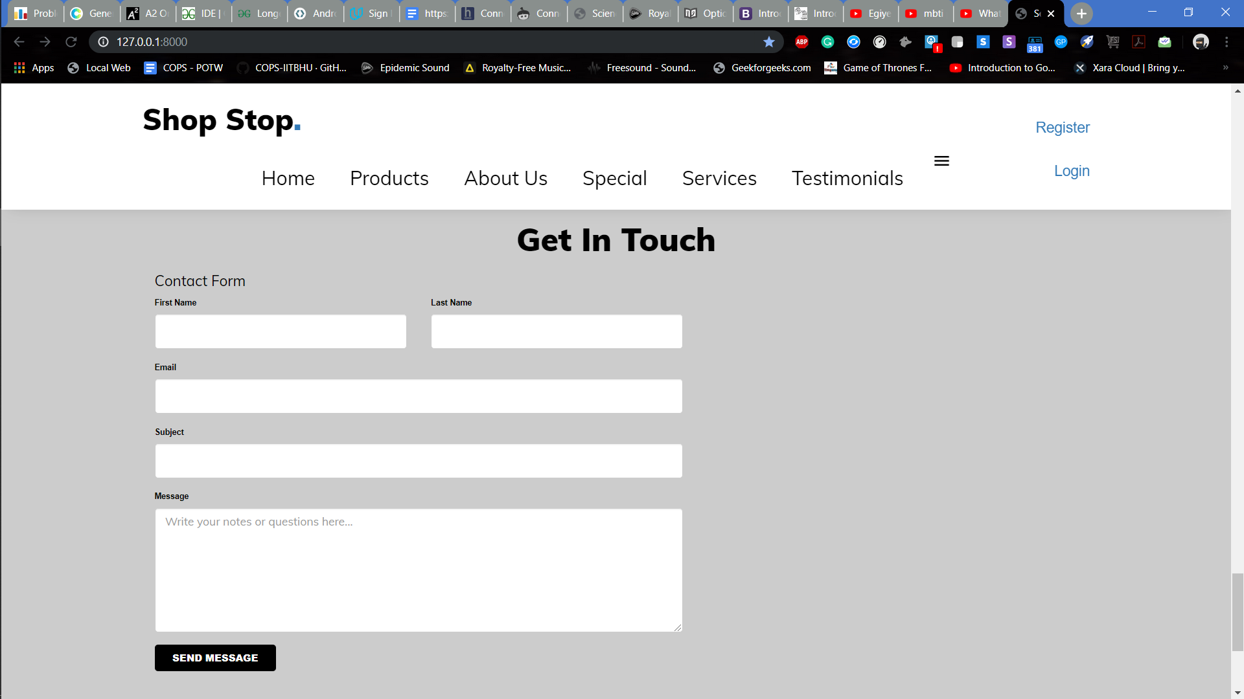
Subscribe to Newsletter
A form which can be filled to subscribe to newsletter.

Slide 14
Thank You.

